Slide 1
Atomic emission spectra
When an element is heated, it will absorb energy. It’s electrons will move to higher energy levels and fall back down to the ground state, emitting light which can be analysed.

Slide 2
Each element has a unique set of energy levels, so when the electrons move between the energy levels, it will involve absorption and emission of energy particular to that element. This means that every element will emit light with a different set of wavelengths to every other element.

Slide 3
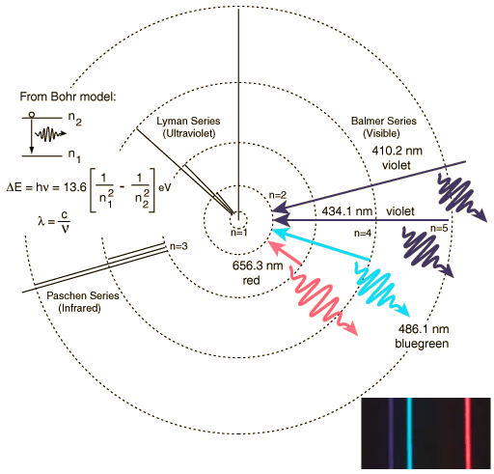
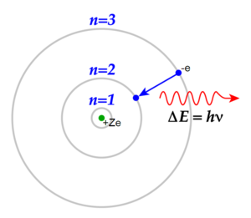
Excited electrons return to lower energy levels emitting energy
E₁=Energy in ground state
E₂=Energy in excited stated.
Overall energy= E₁-E₂

Slide 4
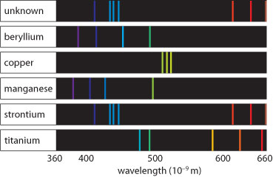
Line emission spectra:
Spectrum unique to each element

Slide 5
Use emission spectroscopy:
Emission spectroscopy is a qualitative tool – it can identify elements present in a sample but does not measure how much of each is present.

Slide 6
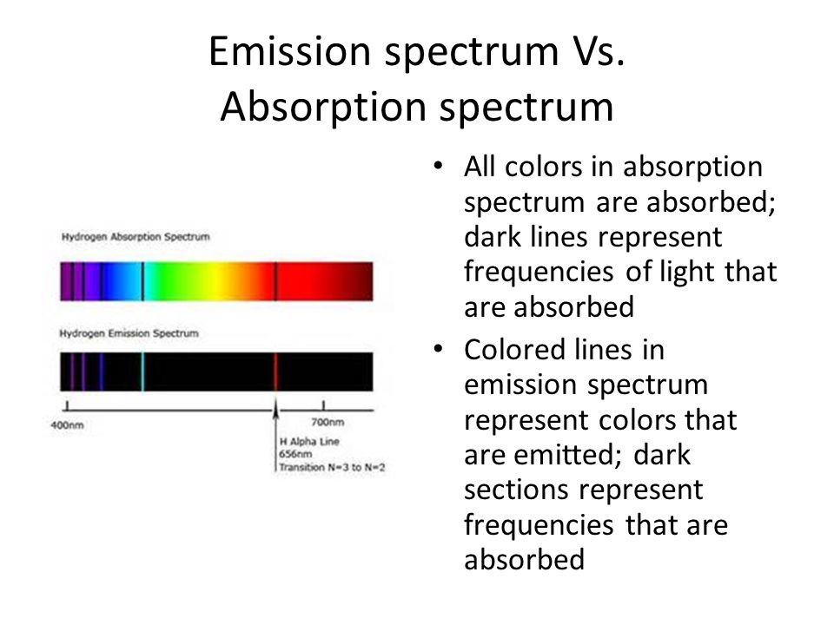

Slide 7
Atomic absorption spectra
A technique used to identify the presence and concentration of substances by analysing the spectrum produced when a substance is vaporised and absorbs certain frequencies of light.
AAS is used particularly for detecting the concentrations of metal ions in solutions.

Slide 8
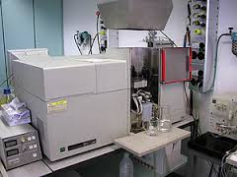

Slide 9
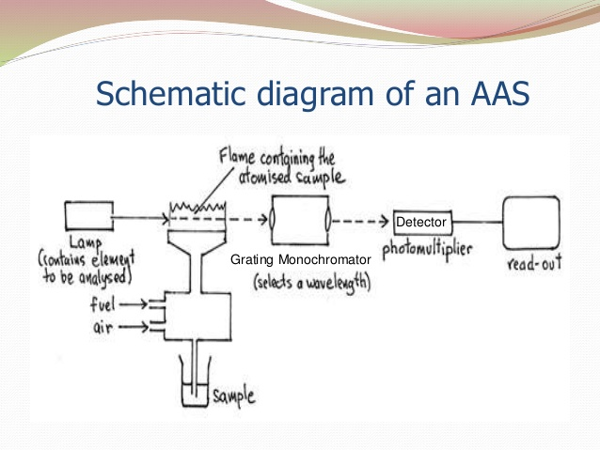

Slide 10
How absorption spectroscopy is done:
1. In AAS a hollow cathode lamp of the metal being analysed is used. This provides the specific wavelengths of light particular to that element.

Slide 11
2. The sample is vaporised in a flame which turns substances it contains into atoms. The light from the lamp passes through the vaporised sample. The element being investigated will absorb the specific wavelengths of light.

Slide 12
3. A particular chosen wavelength is selected using a monochromator and the intensity of that light is measured by a detector. When the substance is not present the maximum amount of light will be detected. When the concentration of the substances increases the element will absorb more of the specific wavelength of light and less of this light will get through.

Slide 13
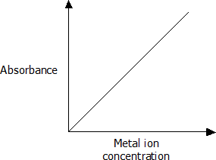
Involves the use of a calibration graph.

